Slide 1

Feature Clustering Analysis
Gray Selby
Dr. M. Kuchera
ALPhA
AT-TPC

Slide 2
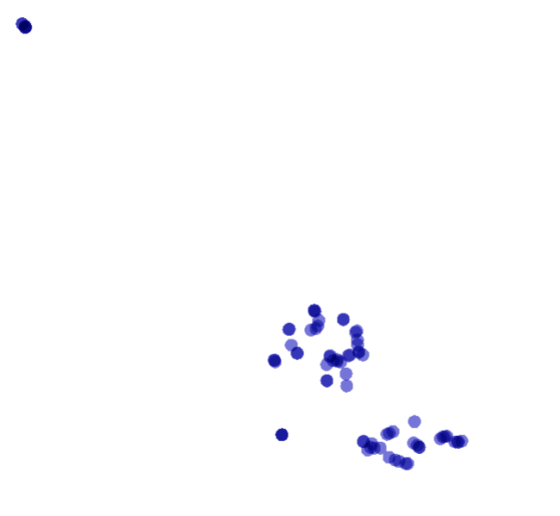
New Images (threshold of 50) with updated ‘hit’ algorithm
Group 1
The images were inverted and my new method of peak determination was used
We see 4 primary groupings
Group 2
Group 3
Group 4

Slide 3

Group 1
29
21
Subgroup A
Contains white ‘junk’ events
26
Subgroup B
34
37
35

Slide 4
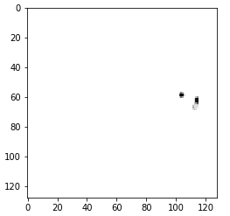

Group 1 Subgroup A
Event 29
Events 29 and 21 were clustered essentially on top of each other in group 1
Event 21

Slide 5
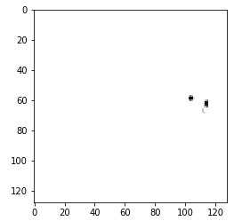



Event 26
Event 37
Group 1
Subgroup B
Events 26, 34, 35, and 37 were all clustered closely, especially event 33 and 34
Event 34
Event 35

Slide 6
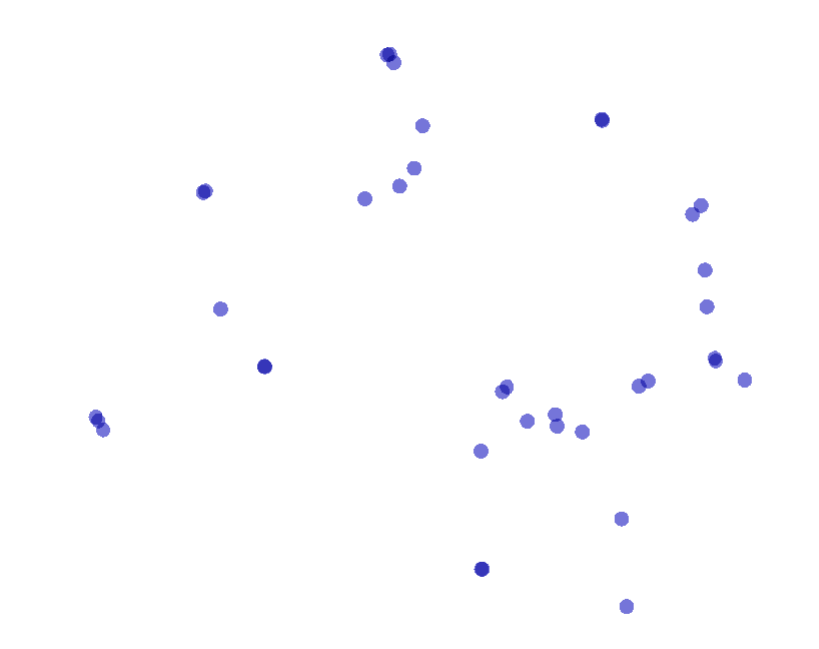
32, 48, 69
Group 2
5, 14
28
23, 70
47
Subgroup A
Short particle tracks (possibly alpha particles) without much of a curl
Subgroup B
Mostly small junk events (only charge in the middle where the beam comes in) except two that may have contain a very short particle track
Subgroup A
55
11, 18
13
60
Subgroup B
57
73
6, 41
45, 51
17, 66
67, 68
12, 24
3
56
25
7, 63, 74
10
39
30, 59
27

Slide 7
Group 2 subgroup A
From top to bottom

Slide 8
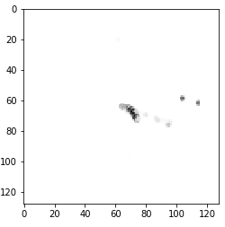
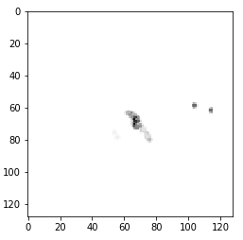
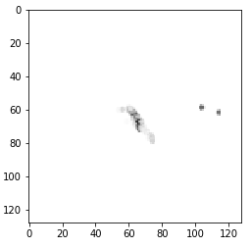
Group 2
Subgroup A
Event 32
Event 48
Event 69

Slide 9
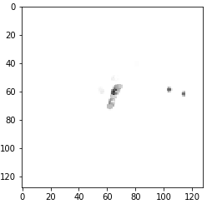
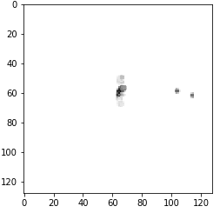

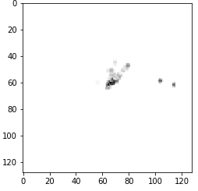
Group 2
Subgroup A
Event 28
Event 47
Event 13
Event 55

Slide 10
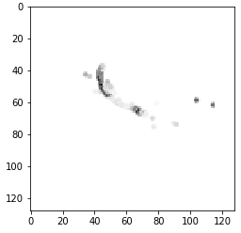
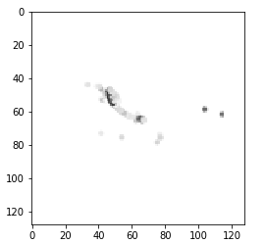
Group 2
Subgroup A
Clustered on top of each other
Event 23
Event 70

Slide 11
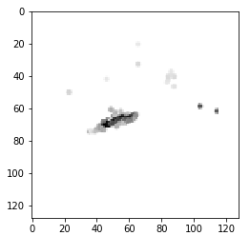
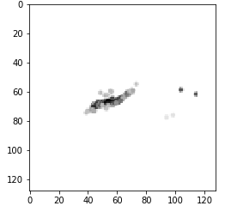
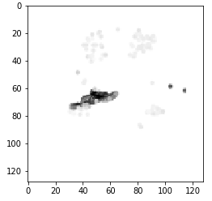
Group 2
Subgroup A
Clustered on top of each other
Event 67
Event 57
Event 68

Slide 12
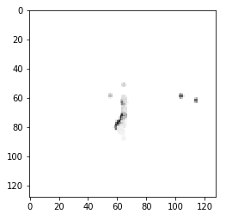
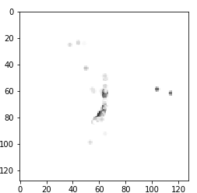
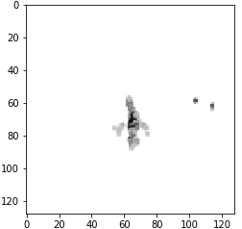
Group 2
Subgroup A
Event 7
Event 63
Event 74

Slide 13
Group 2 subgroup B
From top to bottom

Slide 14
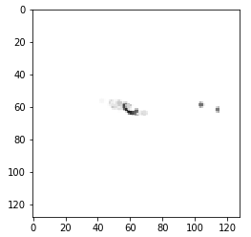
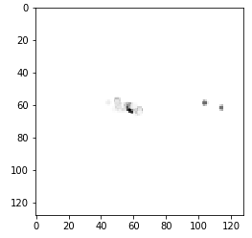
Group 2
Subgroup B
Clustered on top of each other
Event 5
Event 14

Slide 15
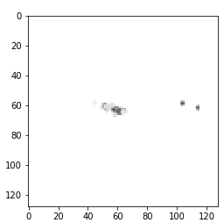

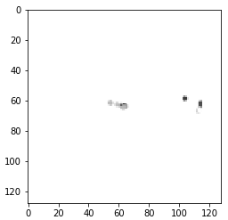

Group 2
Subgroup B
Event 11
Event 18
Event 60
Event 73

Slide 16





Group 2
Subgroup B
Event 17
Event 66
Event 6
Event 41
Event 3

Slide 17






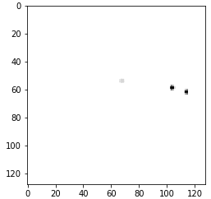
Group 2
Subgroup B
Event 45
Event 51
Event 12
Event 24
Event 56
Event 25
Event 10

Slide 18
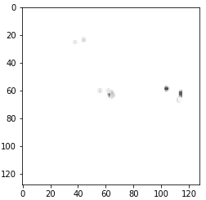
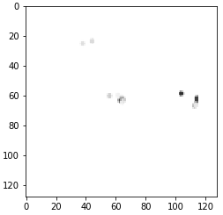
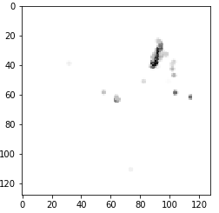
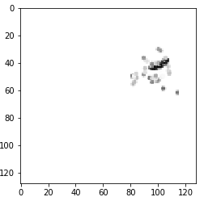
Group 2
Subgroup B
Event 59
Event 30
Event 39
Event 27

Slide 19

Group 3
‘junk’ events
8, 43, 71

Slide 20
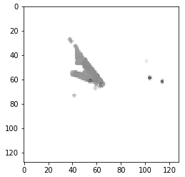
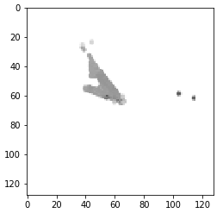

Group 3
Event 8
Event 43
Event 71

Slide 21
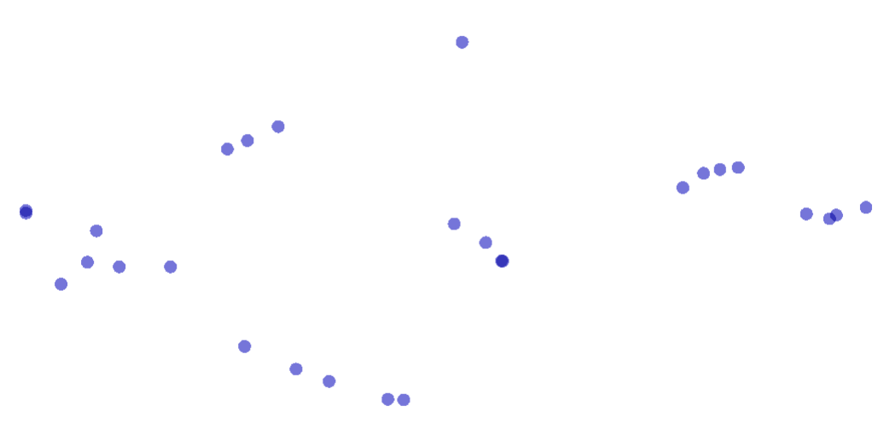
Group 4
42
50, 19, 40
54, 49, 15, 65
22, 36
33
1
38
64
20
44, 53
4
52
61
31, 72
58
62
2
16
46, 9

Slide 22
Group 4
Moving left to right
There is one outlier that appears to be a ‘junk’ event (event 42)
The rest are curling particle tracks (one or multiple tracks)

Slide 23
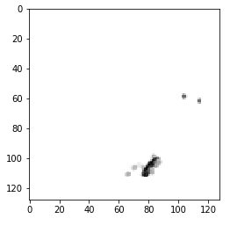
Group 4
Outlier
Event 42

Slide 24
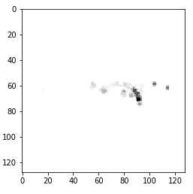
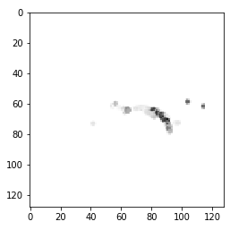
Group 4
Event 22
Event 36

Slide 25
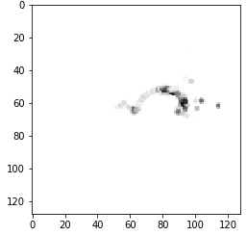
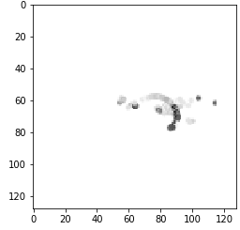
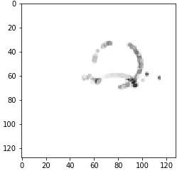
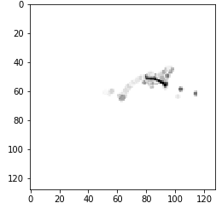
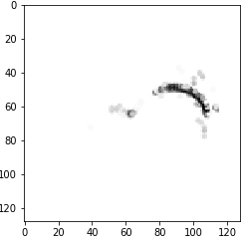
Group 4
Event 4
Event 38
Event 52
Event 58
Event 61

Slide 26
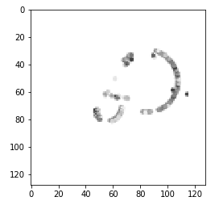
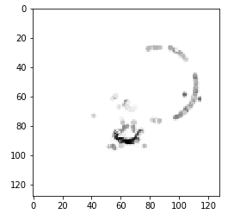
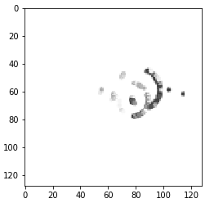
Group 4
Event 19
Event 40
Event 50

Slide 27
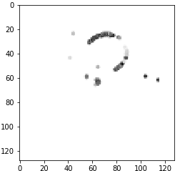
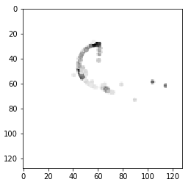
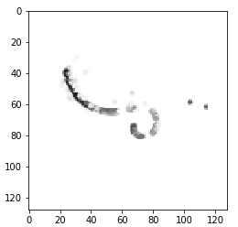
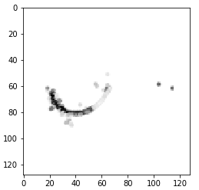
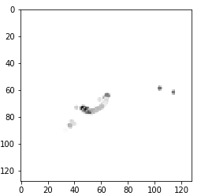
Group 4
Event 62
Event 2
Event 16
Event 46
Event 9

Slide 28
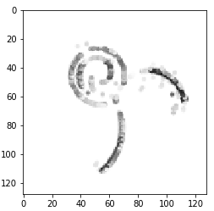
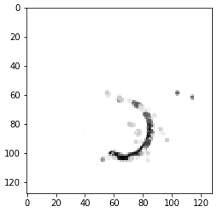
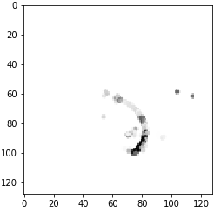
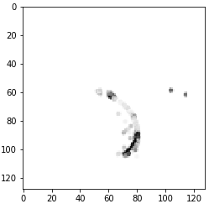
Group 4
Event 64
Event 20
Event 31
Event 72

Slide 29




Group 4
Event 15
Event 49
Event 54
Event 65

Slide 30




Group 4
Event 33
Event 44
Event 1
Event 53

Slide 31
Conclusion
Clustering showed that the pretrained CNN is able to distinguish between events
Group 4 contained all of the easily identifiable swirls with only one junk event clustered on the edge
The CNN does seem to have more trouble with the short particle traces in group 2 but these short particle traces are almost entirely contained within group 2 subgroup A and junk events similar to group 1 are found in group 2 subgroup B

